Slide 1
Malicious Attack Detection and Blocking using Semi-supervised Machine Learning Techniques in Optical Burst Switching Network
Presented By
Md. Kamrul Hossain
Roll No.: 15MCSE043P
Supervised By
Dr. Md. Mokammel Haque
Professor,
Dept. of CSE, CUET

Slide 2
Contents
Introduction
Motivation
Previous Work
Objectives
Methodology
Conclusion
References

Slide 3
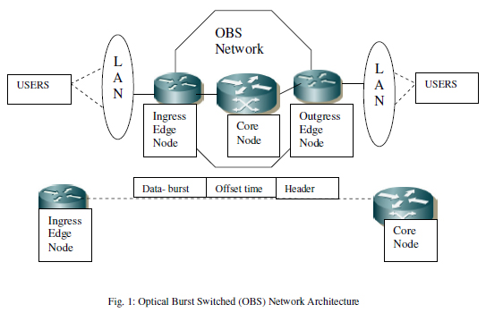
Introduction
Optical burst switching (OBS) network is a switching technology.
It works by assembling UDP packets(Data Burst) and sending a burst header packet (BHP) in order to reserve the required network resources before sending the corresponding data burst.

Slide 4
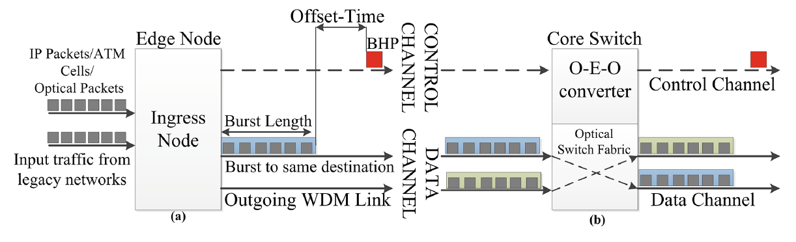
Introduction (Cont.)
Optical Burst Switching Network:

Slide 5
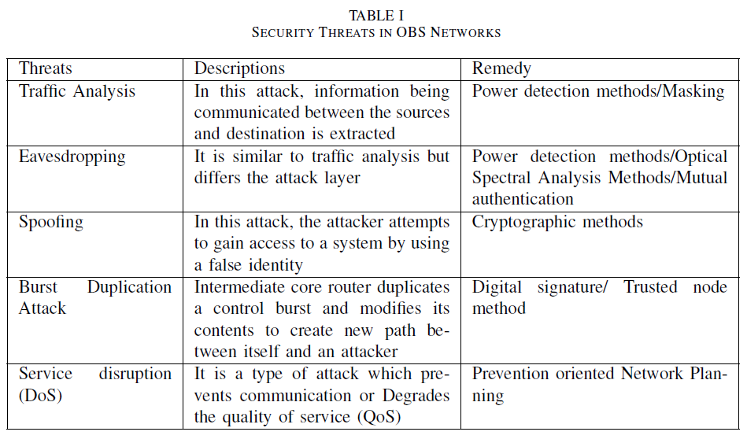
Introduction (Cont.)

Slide 6
Introduction (Cont.)
Threats in OBS networks
Threat | Description
Land Attack | the compromised node copies the BHP and transmits back to the source and to the intended destination.
Burstification attack | changing the value of the size of the assembled bursts at the BHP. The increased burst size value could push the egress node to check the value of the same during disassembly

Slide 7
Introduction (Cont.)
DoS attacks in OBS networks
BHP flooding attack
DB flooding attack

Slide 8
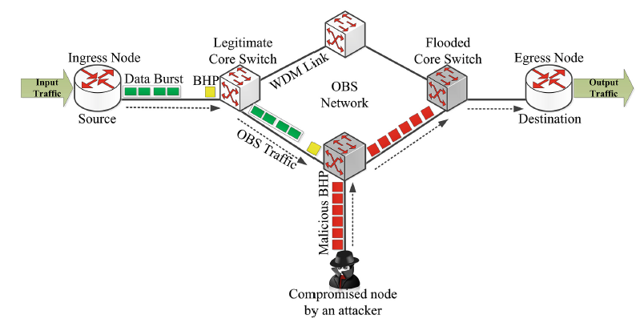
Introduction (Cont.)
BHP flooding attack
Here, a source node gets compromised by an attacker and floods the network with only BHPs to reserve resources without sending actual data.

Slide 9
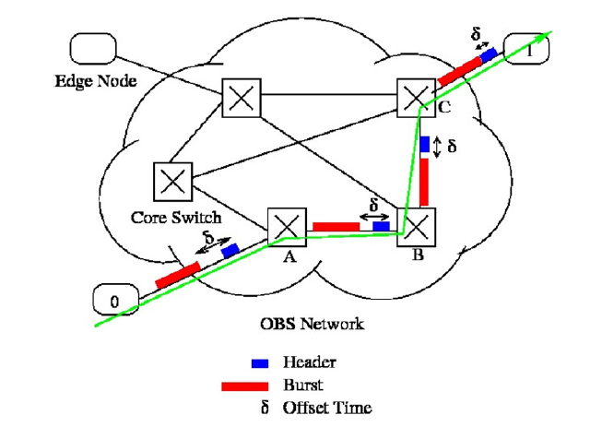
Introduction (Cont.)
DB flooding attack
Here, one or more source nodes send fake/malicious data bursts(DB) continuously to flood the network.

Slide 10
Motivation
Optical burst switching (OBS) is a promising technique for next-generation optical switching networks
It attempts to address the problem of efficiently allocating resources for bursty traffic
It facilitates high bandwidth utilization
Very few researches have been done on the security of OBS network, therefore it is a promising field of research

Slide 11
Motivation (Cont.)
State-of-the-art optical network control tools are typically configured as rule-based expert systems
Such rules are specialized and deterministic and usually in the order of a few tens, and cannot cover all the possible cases of malfunctions.

Slide 12
Related works
"Countering burst header packet flooding attack in optical burst switching network." (Rajab et al., International Conference on Information Security Practice and Experience, Springer, 2016.)
  Authors proposed a new security model to prevent BHP flooding attacks. The model allows the OBS core switch to classify the ingress nodes based on their behavior and the amount of reserved resources that are not being utilized.
  They did not use any machine learning
  They did not discuss about fake burst send by malicious nodes

Slide 13
Related works (Cont.)
“Decision tree rule learning approach to counter burst header packet flooding attack in Optical Burst Switching network." (Rajab et al., Optical Switching and Networking, Elsevier, 2018)
  Authors proposed a supervised, decision tree-based architecture that extracts rules.
  The results showed that the rules derived accurately classify 93% of the BHP flooding attacks into either Behaving (B) or Misbehaving (M) classes.
  Moreover, the rules can further classify the Misbehaving edge nodes(M) into four sub-class labels with 87% accuracy.
  They did not discuss about empty burst send by malicious nodes
Notes:
Their prediction method covers the discovered rules in a top-down fashion and assigns the class of the rule matching the test case variables’ values. If no rules fully match, then the class label of the first partly matching rule will be assigned to the test case. If no rules partly match the test case, then the majority class in the training dataset is given to the test case.

Slide 14
Related works (Cont.)
"A Survey on Application of Machine Learning Techniques in Optical Networks." (Musumeci et al., arXiv, 2018)
  Authors suggested that, after learning from a batch of available past samples, other types of algorithms, in the field of semi-supervised and/or unsupervised ML, could be implemented to gradually take in novel input data as they are made available by the network control plane.

Slide 15
Related works (Cont.)
"Artificial intelligence (AI) methods in optical networks: A comprehensive survey." (Optical Switching and Networking, Elsevier, 2018)
  Authors suggested that, artificial intelligence will continue playing an important role in supporting emerging transmission technologies like space division multiplexing, multimode/multicore fibers and advanced modulation formats and constellation shaping. So, research should be increased on these fields.

Slide 16
Related works (Cont.)
"Secure burst control packet scheme for Optical Burst Switching networks." (Coulibaly et al., Broadband and Photonics Conference (IBP), IEEE, 2015)
  Authors proposed a solution to address Data Burst Redirection (DBR) Attack in OBS networks. The solution is designed based on Rivest-Shamir-Adleman (RSA) public-key encryption algorithm.
  But they only detected fraud BHP and did not classify the compromised nodes based on their behavior.

Slide 17
Related works (Cont.)
"Secure optical burst switching: Framework and research directions." (Chen et al., IEEE Communications magazine, 2008)
  Authors outlined several security concerns in OBS networks like orphan bursts, malicious burst headers etc.
  They introduced key based authentication of burst headers and confidentiality of data bursts

Slide 18
Research Objectives
Find a better solution to BHP flooding attack
Design and implementation of a ML based Data Burst flooding attack prevention model
Propose a semi-supervised machine learning architecture for a sustainable defense against DoS attack

Slide 19
Proposed Methodology
Preventing BHP flooding attack:
A malicious node that causes BHP flooding attack will be blocked by the developed model until the risk disappears.
We propose an improvement strategy for BHP flooding attacks detection using machine learning model.
Our aim is find a better classification of the node

Slide 20

Proposed Methodology
Steps to boost the performance of
existing BHP flooding attack prevention model :

Slide 21
Proposed Methodology
Improving existing BHP flooding attack prevention model:
Adding more data
  A large dataset facilitates better accuracy
Treating missing and outlier values well
  Predictive model, KNN imputation to treat missing values
  Transformation, imputation to treat outliers
Feature engineering
  Feature transformation, Feature Creation
Feature selection
  Visualization, statistical parameter analysis

Slide 22
Proposed Methodology
Improving existing BHP flooding attack prevention model accuracy:
Algorithm tuning
  Find the optimum value for each parameter
Using multiple algorithm
  Random forest, neural networks etc.
  Ensemble methods
Cross validation
  K-fold cross validation, validation set approach etc.

Slide 23
Proposed Methodology (Cont.)
Preventing Fake/Malicious Data-Burst attack:
Our aim is to generate a dataset using NCTUns simulator that represents a network flooded with fake/malicious DB
After gathering necessary data, we will assign node status by a domain expert, either behaving or not behaving.
Then after performing necessary preprocessing of data, we will use supervised machine learning model to train and test our model

Slide 24
Proposed Methodology (Cont.)
Features to consider in preventing Fake/Malicious Data-Burst attack:
Threshold (Packets/Sec) :
  If the rate of packets per second sent to/from a node exceeds a certain threshold, then flood protection trigger will be activated.
Length or time duration of burst (Sec) :
  The BHP specifies the length(time duration) of the upcoming bursts.
  Examining the specified and actual duration of the burst can help prevent burst flooding.

Slide 25
Proposed Methodology (Cont.)
Features to consider in preventing Fake/Malicious Data-Burst attack:
Amount of resource usage within the system
  No blocking until resources are saturated to a certain threshold
States of data at different levels of the network stack
  Data will be collected from more than one layer
Past and present behavior of edge node in context of a DOS attack
  Each nodes behavior will be monitored. After a DoS is detected, its current and past behavior will be compared
Notes:
In this approach distributed agents are used. They report resource utilisation levels to the master at regular intervals. These values are compared against threshold values configured by the administrator. If the limits are exceeded the system is considered to be under attack.

Slide 26
Proposed Methodology (Cont.)
Tentative features to consider for learning
Number of the sending node
Utilized bandwidth rate
Packet drop rate
Reserved bandwidth
Average delay time per second
Percentage of lost packet rate
Percentage of lost byte rate
Packet received rate
Used bandwidth
Lost bandwidth
Packet Size Byte
Packet Transmitted
Packet Received
Packet lost
Transmitted Byte
Received Byte
10-Run-AVG-Drop-Rate
10-Run-AVG-Bandwidth-Use
10-Run-Delay

Slide 27
Proposed Methodology (Cont.)
Classifying Label:
Node Status {B, NB}:
B = Behaving,
NB = Not Behaving

Slide 28
Proposed Methodology (Cont.)
Machine Learning model for detecting fake/malicious DB:
Data preprocessing module
Machine learning algorithm
Raw data
Data
Pre-processing
Prepared data
Apply algorithm
Candidate model
Chosen model
Raw data
Iterate for best module
Application

Slide 29
Proposed Methodology (Cont.)
Proposed Semi-supervised machine learning framework:
Majority of existing studies adopting ML use offline supervised learning methods.
This assumption is often unrealistic for optical communication networks, where scenarios dynamically evolve with time(traffic variation, aging etc.)
After learning from a batch of available past samples, other types of algorithms, in the field of semi-supervised ML, could be implemented to gradually take in novel input data as they are made available by the network control plane.

Slide 30
Proposed Methodology (Cont.)
A supervised framework:
Misbehaving Node
Labeled
Data
Train
Model
Predict
Behaving Node
Unknown Node
Behaving Node
Misbehaving Node
Supervised ML will be initially used, labels will be given by a domain expert

Slide 31
Proposed Methodology (Cont.)
A semi-supervised framework:
Unlabeled
Data
Train
Model
Classify
Labeled Data
Behaving/Misbehaving Node
Unlabeled nodes separated into groups
Semi-supervised ML will be used if existing ML model cannot prevent DoS attack
Very little human intervention is needed for further examining the groups

Slide 32
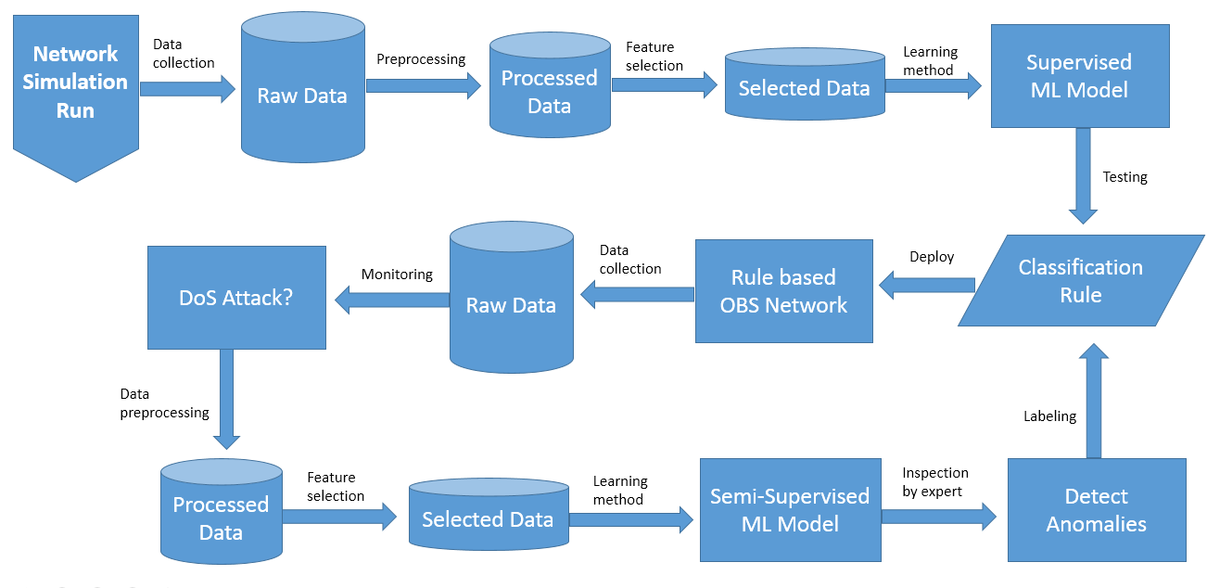
Proposed Methodology (Cont.)
Machine learning framework for flooding attack prevention

Slide 33
Proposed Methodology (Cont.)
Algorithm Selection:
For supervised learning:
  Random forest
  Neural network
For Semi-supervised learning:
  Self-Training
  Label propagation

Slide 34

Proposed Methodology (Cont.)
Machine learning tool:
Scikit-learn: It is a free machine learning library for the Python programming language

Slide 35
Proposed Methodology (Cont.)
Data Collection:
Dataset from University of California Irvine (UCI) repository, namely, “Burst Header Packet (BHP) flooding attack on Optical Burst Switching (OBS) Network Data Set.”
Dataset from NCTUns network simulator

Slide 36
Proposed Methodology (Cont.)
Evaluation:
The security model will be implemented, tested and verified using NCTUns software
We shall compare our work with some other similar work.

Slide 37
Conclusion
In this thesis, we shall implement machine learning model to prevent BHP and DB flooding attacks in optical burst switching network
We shall design and evaluate a framework that combines supervised and semi-supervised machine learning model for a sustainable defense against those threats

Slide 38
References
Rajab, Adel, et al. "Countering burst header packet flooding attack in optical burst switching network." International Conference on Information Security Practice and Experience. Springer, Cham, 2016.
Rajab, Adel, Chin-Tser Huang, and Mohammed Al-Shargabi. "Decision tree rule learning approach to counter burst header packet flooding attack in Optical Burst Switching network." Optical Switching and Networking 29 (2018): 15-26.
Musumeci, Francesco, et al. "A Survey on Application of Machine Learning Techniques in Optical Networks." arXiv preprint arXiv:1803.07976 (2018).
Mata, Javier, et al. "Artificial intelligence (AI) methods in optical networks: A comprehensive survey." Optical Switching and Networking (2018).
Coulibaly, Yahaya, et al. "Secure burst control packet scheme for Optical Burst Switching networks." Broadband and Photonics Conference (IBP), 2015 IEEE International. IEEE, 2015.
Chen, Yuhua, and Pramode K. Verma. "Secure optical burst switching: Framework and research directions." IEEE Communications magazine 46.8 (2008).

